Slide 1
Lecture 5
Solving systems of linear equations with the LU decomposition

Slide 2
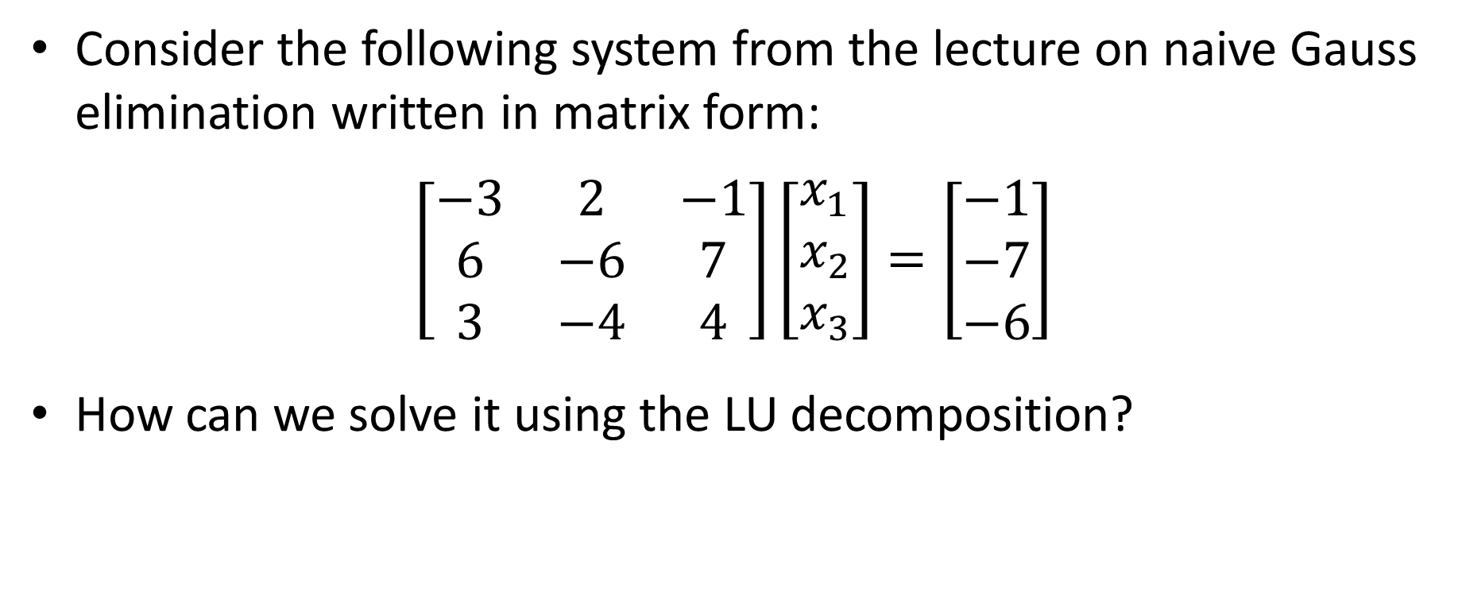
Introduction
Consider the following system from the lecture on naive Gauss elimination written in matrix form:
$$\left[\begin{matrix}−3 & 2 & −1 \\ 6 & −6 & 7 \\ 3 & −4 & 4\end{matrix}\right]\left[\begin{matrix}x_{1} \\ x_{2} \\ x_{3}\end{matrix}\right]=\left[\begin{matrix}−1 \\ −7 \\ −6\end{matrix}\right]$$
How can we solve it using the LU decomposition?
Notes:
In this lecture we will discuss two applications of the LU decomposition
The first one is for solving linear systems.
The second one will be for the calculation of determinants
Let us start to try to understand how the LU decomposition can be used to sole a system of equations.
Consider the system displayed
How can we solve it by taking advantage of the LU decomposition?

Slide 3
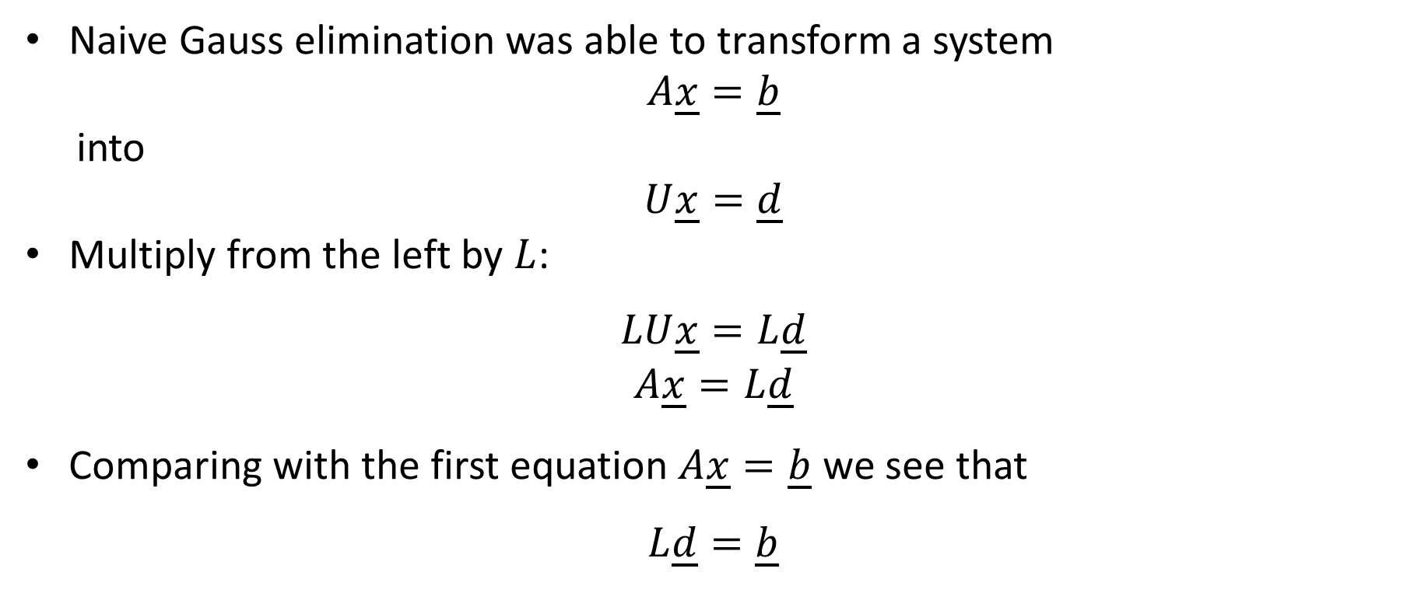
Naive Gauss elimination was able to transform a system
$$A\underline{x}=\underline{b}$$
into
$$U\underline{x}=\underline{d}$$
Multiply from the left by $L$:
$$LU\underline{x}=L\underline{d}$$
$$A\underline{x}=L\underline{d}$$
Comparing with the first equation $A\underline{x}=\underline{b}$ we see that
$$L\underline{d}=\underline{b}$$
Notes:
Recall that the naïve Gauss elimination algorithm is able to transform a system Ax=b into an upper diagonal system Ux=d
Multiply form the left this system by L
We obtain LUx=Ld
But LU is equal to A
Consequently we can write
Ax=Ld
Comparing with the equation Ax=b, we note that Ld must be equal to b.
This simple calculation gives us the algorithm to solve a system of equations using the LU decomposition

Slide 4
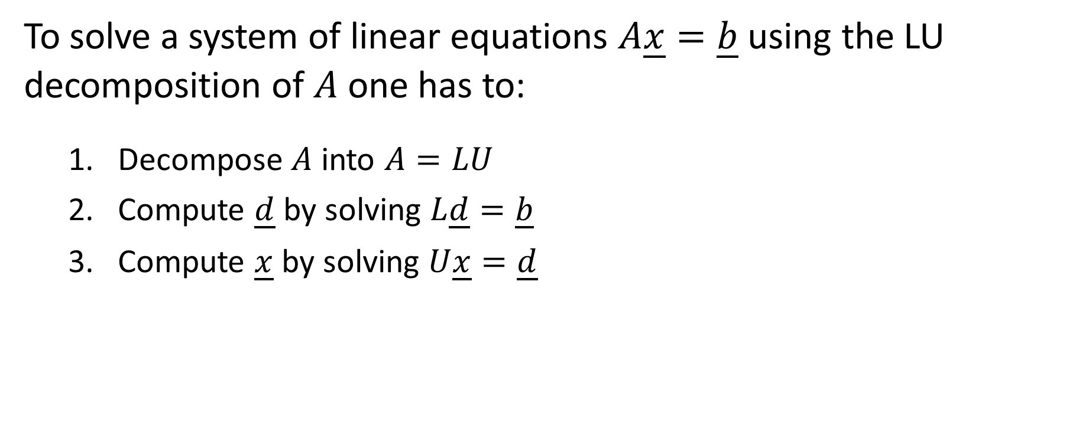
Solving systems of linear equations with the LU decomposition
To solve a system of linear equations $A\underline{x}=\underline{b}$ using the LU decomposition of $A$ one has to:
Decompose $A$ into $A=LU$
Compute $\underline{d}$ by solving $L\underline{d}=\underline{b}$
Compute $\underline{x}$ by solving $U\underline{x}=\underline{d}$
Notes:
To solve a system of linear equations $A\underline{x}=\underline{b}$ using the LU decomposition of $A$ one proceeds in three steps
First: decompose $A$ into $A=LU$
Second: compute $\underline{d}$ by solving $L\underline{d}=\underline{b}$
And third: compute $\underline{x}$ by solving $U\underline{x}=\underline{d}$

Slide 5

Example
Solve the following system
$$\left[\begin{matrix}−3 & 2 & −1 \\ 6 & −6 & 7 \\ 3 & −4 & 4\end{matrix}\right]\left[\begin{matrix}x_{1} \\ x_{2} \\ x_{3}\end{matrix}\right]=\left[\begin{matrix}−1 \\ −7 \\ −6\end{matrix}\right]$$
Notes:
Let us illustrate this algorithm with an example
We will solve the displayed system

Slide 6

Example – Step 1
We know already how to find the LU decomposition of $A$:
$$\left[\begin{matrix}−3 & 2 & −1 \\ 6 & −6 & 7 \\ 3 & −4 & 4\end{matrix}\right]=\left[\begin{matrix}1 & 0 & 0 \\ −2 & 1 & 0 \\ −1 & 1 & 1\end{matrix}\right]\left[\begin{matrix}−3 & 2 & −1 \\ 0 & −2 & 5 \\ 0 & 0 & −2\end{matrix}\right]$$
Notes:
First we need the LU decomposition of the coefficient matrix
We already found this decomposition previously

Slide 7

Example – Step 2
We solve $L\underline{d}=\underline{b}$:
$$\left[\begin{matrix}1 & 0 & 0 \\ −2 & 1 & 0 \\ −1 & 1 & 1\end{matrix}\right]\left[\begin{matrix}d_{1} \\ d_{2} \\ d_{3}\end{matrix}\right]=\left[\begin{matrix}−1 \\ −7 \\ −6\end{matrix}\right]$$
$$\left[\begin{matrix}d_{1} \\ d_{2} \\ d_{3}\end{matrix}\right]=\left[\begin{matrix}−1 \\ −9 \\ 2\end{matrix}\right]$$
Notes:
In the second step we compute d by solving Ld=b
As L is a lower diagonal matrix, the solution is straight forward
D1 will always be the first entry of b
D2 is then found using the known value d1.
In our case d2 is equal to -7 plus two times d1. This gives us -9
And in similar way one finds d3.
This process is similar to back substitution.
But instead of starting with the last equation, one starts with the first.
That is why this process is called forward substitution.

Slide 8

Example – Step 3
We solve $U\underline{x}=\underline{d}$:
$$\left[\begin{matrix}−3 & 2 & −1 \\ 0 & −2 & 5 \\ 0 & 0 & −2\end{matrix}\right]\left[\begin{matrix}x_{1} \\ x_{2} \\ x_{3}\end{matrix}\right]=\left[\begin{matrix}−1 \\ −9 \\ 2\end{matrix}\right]$$
$$\left[\begin{matrix}x_{1} \\ x_{2} \\ x_{3}\end{matrix}\right]=\left[\begin{matrix}2 \\ 2 \\ −1\end{matrix}\right]$$
Notes:
The third and last step is to compute x by solving Ux=d.
This is done by back substitution.
I recommend you to repeat the solution of this system using naïve Gauss elimination instead of LU decomposition
You will realize that the back substitution step of the Gauss elimination algorithm is exactly the same as step 3 of the LU decomposition.
In fact, the naïve Gauss algorithm will transform the original system in exactly the system Ux=d displayed here.

Slide 9
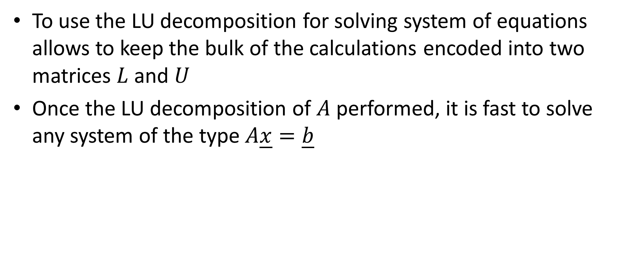
Remarks
To use the LU decomposition for solving system of equations allows to keep the bulk of the calculations encoded into two matrices $L$ and $U$
Once the LU decomposition of $A$ performed, it is fast to solve any system of the type $A\underline{x}=\underline{b}$
Notes:
Let us add some remarks
First let us note that the LU decomposition keeps the bulk of the calculations encoded into two matrices $L$ and $U$
Once the LU decomposition is done, one can solve very easily any system Ax=b, regardless of the right hand side vector b as this vector does not influence the values of the L and U matrices.
Consequently the LU decomposition is very appropriate to use in cases where one has to solve several systems with a same coefficient matrix A but different right hand side vectors b.
When solving only a single system Ax=b, the use of the LU decomposition does not bring a real advantage over the naïve Gauss algorithm.

Slide 10
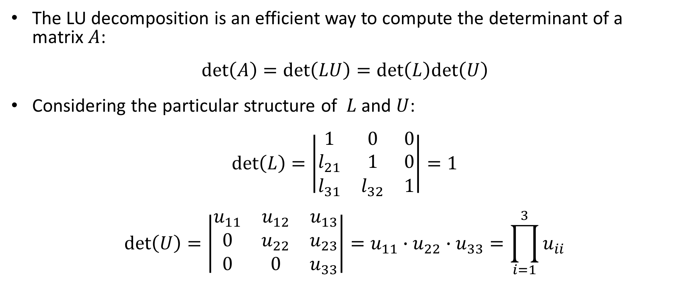
Computing Determinant of a Matrix
The LU decomposition is an efficient way to compute the determinant of a matrix $A$:
$$\text{det}\left(A\right)=\text{det}\left(LU\right)=\text{det}\left(L\right)\text{det}\left(U\right)$$
Considering the particular structure of $L$ and $U$:
$$\text{det}\left(L\right)=\left|\begin{matrix}1 & 0 & 0 \\ l_{21} & 1 & 0 \\ l_{31} & l_{32} & 1\end{matrix}\right|=1$$
$$\text{det}\left(U\right)=\left|\begin{matrix}u_{11} & u_{12} & u_{13} \\ 0 & u_{22} & u_{23} \\ 0 & 0 & u_{33}\end{matrix}\right|=u_{11}∙u_{22}∙u_{33}=\prod_{i=1}^{3}{u_{ii}}$$
Notes:
Let us now move to the second application of the LU decomposition
In fact the LU decomposition is a very efficient way to compute the determinant of a matrix $A$
Let us first note that we can write:$\text{det}\left(A\right)=\text{det}\left(LU\right)$
As the determinant of a product is the product of the determinants, we can further write that $\text{det}\left(LU\right)=\text{det}\left(L\right)\text{det}\left(U\right)$
Recall the particular shape of L.
For a lower diagonal matrix, the determinant is simply the product of it’s diagonal elements. For the case of L we get det(L)=1.
Similarly to compute det(U) we only have to multiply the diagonal elements of U.

Slide 11
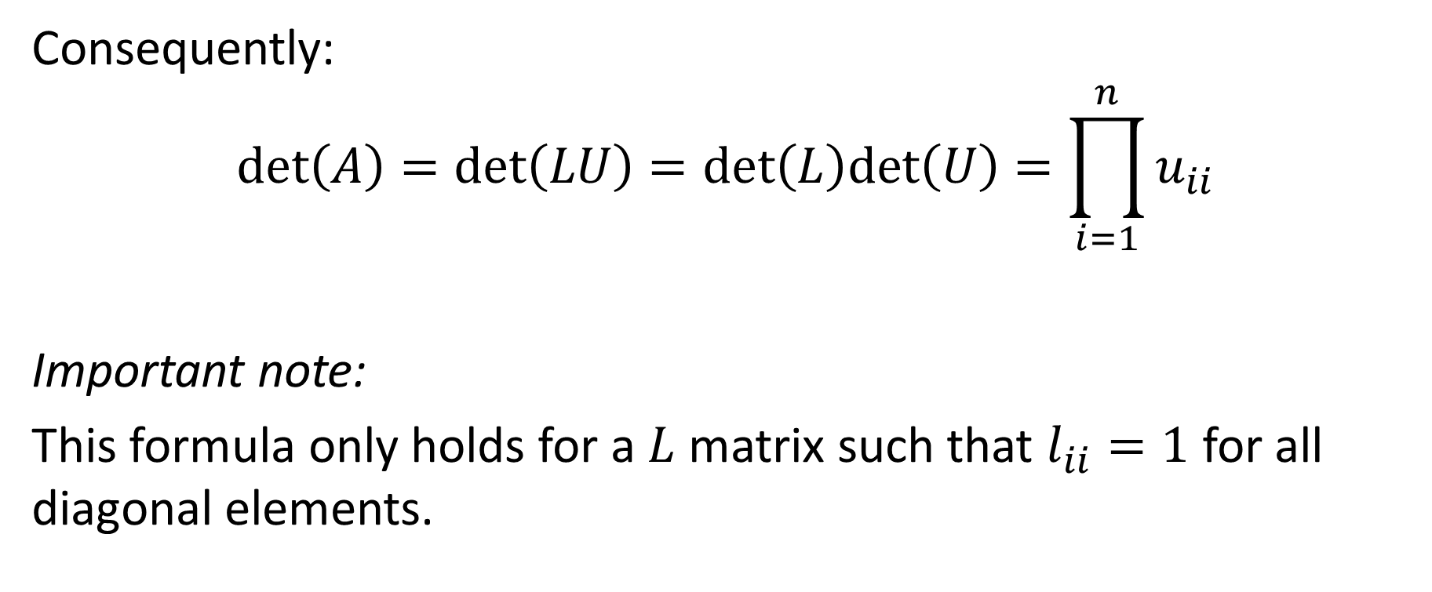
Computing Determinant of a Matrix
Consequently:
$$\text{det}\left(A\right)=\text{det}\left(LU\right)=\text{det}\left(L\right)\text{det}\left(U\right)=\prod_{i=1}^{n}{u_{ii}}$$
Important note:
This formula only holds for a $L$ matrix such that $l_{ii}=1$ for all diagonal elements.
Notes:
In summary we have
Determinant of A is the product of the diagonal elements of U.
Let me insist that this formula is valid only if you use the LU decomposition the way we learned it.
If you use another LU decomposition, where the diagonal elements of the L matrix are different than 1, you will have to adapt this formula.

Slide 12
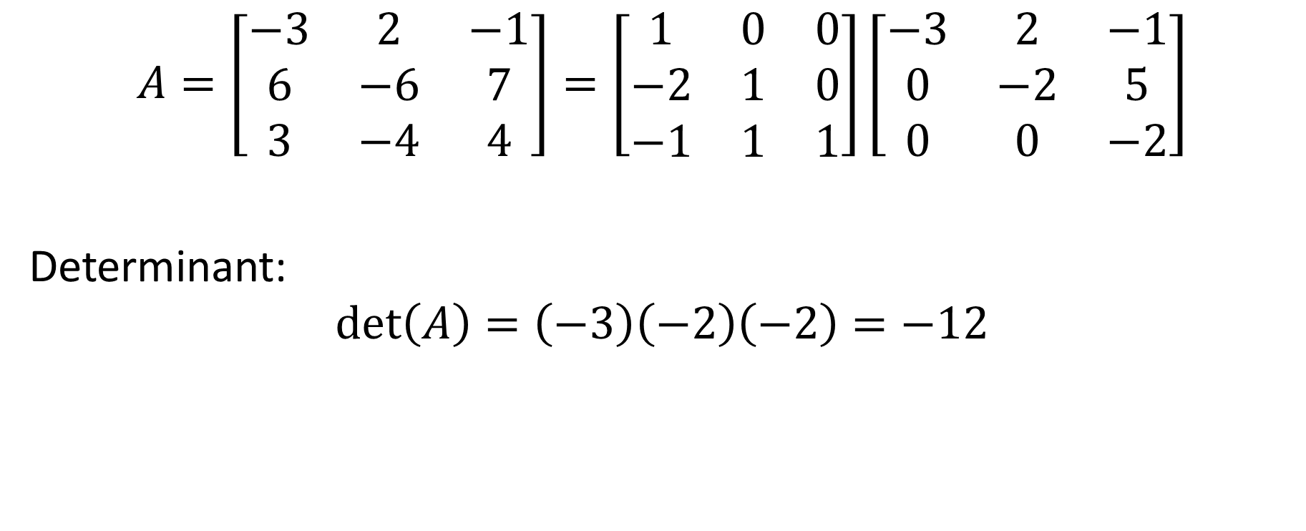
Example
$$A=\left[\begin{matrix}−3 & 2 & −1 \\ 6 & −6 & 7 \\ 3 & −4 & 4\end{matrix}\right]=\left[\begin{matrix}1 & 0 & 0 \\ −2 & 1 & 0 \\ −1 & 1 & 1\end{matrix}\right]\left[\begin{matrix}−3 & 2 & −1 \\ 0 & −2 & 5 \\ 0 & 0 & −2\end{matrix}\right]$$
Determinant:
$$\text{det}\left(A\right)=\left(−3\right)\left(−2\right)\left(−2\right)=−12$$
Notes:
Let us consider the matrix A displayed.
Using the LU decomposition of A we get right away the determinant of A by multiplying the diagonal elements of U: $\text{det}\left(A\right)=\left(−3\right)\left(−2\right)\left(−2\right)=−12$

Slide 13
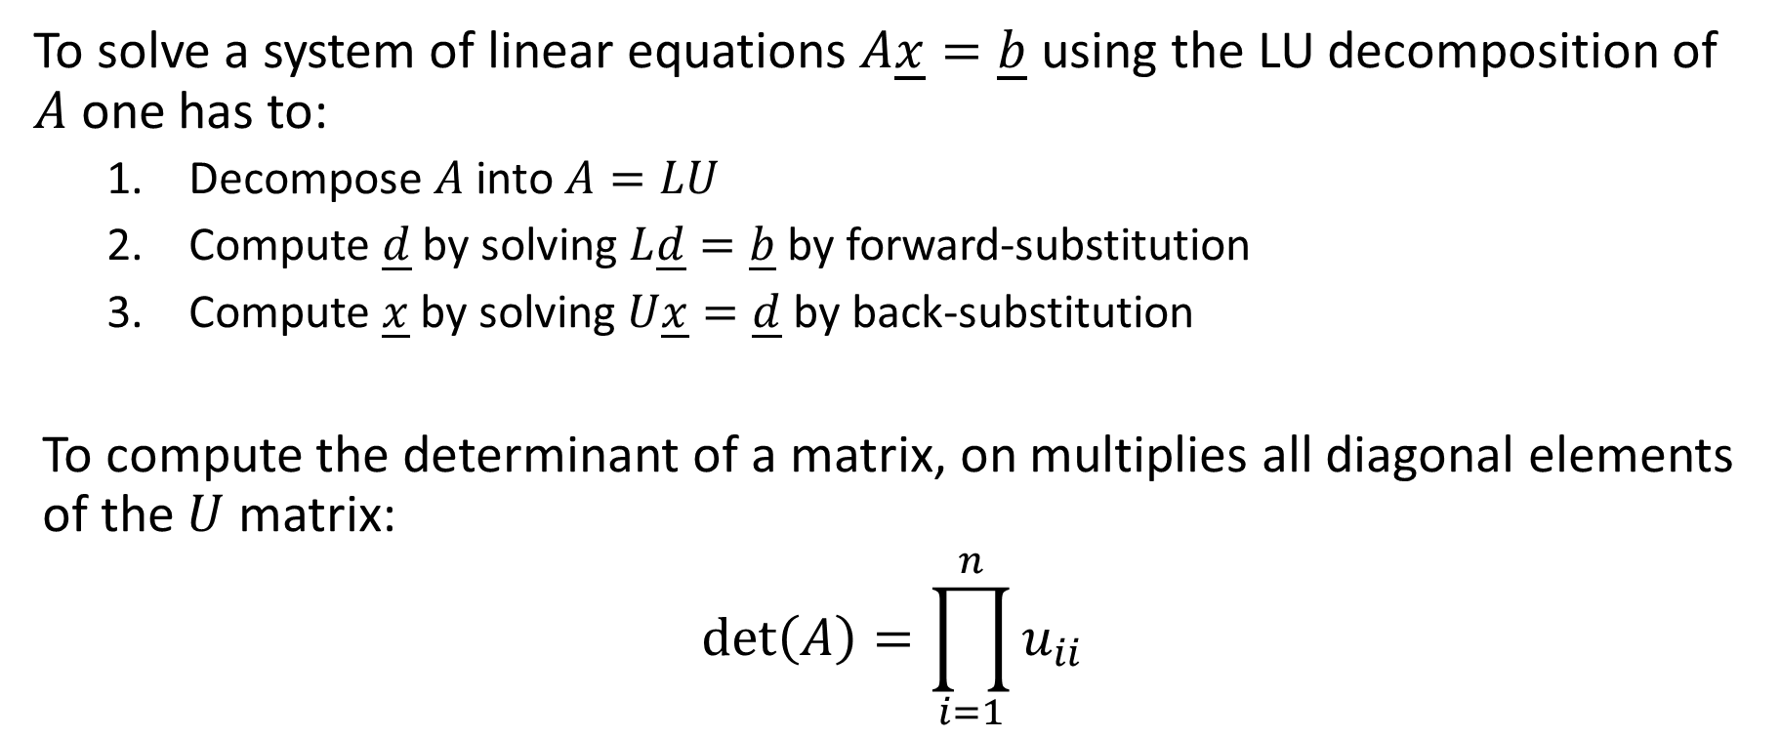
Summary
To solve a system of linear equations $A\underline{x}=\underline{b}$ using the LU decomposition of $A$ one has to:
Decompose $A$ into $A=LU$
Compute $\underline{d}$ by solving $L\underline{d}=\underline{b}$ by forward-substitution
Compute $\underline{x}$ by solving $U\underline{x}=\underline{d}$ by back-substitution
To compute the determinant of a matrix, on multiplies all diagonal elements of the $U$ matrix:
$$\text{det}\left(A\right)=\prod_{i=1}^{n}{u_{ii}}$$
Notes:
Let us summarize the key findings
To solve a system of linear equations $A\underline{x}=\underline{b}$ using the LU decomposition of $A$ one has to:
First decompose $A$ into $A=LU$
Second compute $\underline{d}$ by solving $L\underline{d}=\underline{b}$ by forward-substitution
And third compute $\underline{x}$ by solving $U\underline{x}=\underline{d}$ by back-substitution
To compute the determinant of a matrix, on multiplies all diagonal elements of the $U$ matrix.

